Slide 1

CSE 473
Pattern Recognition

Slide 2
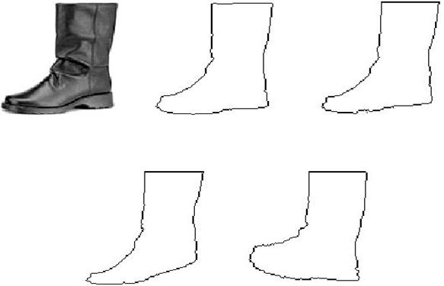
Template Matching

Slide 3

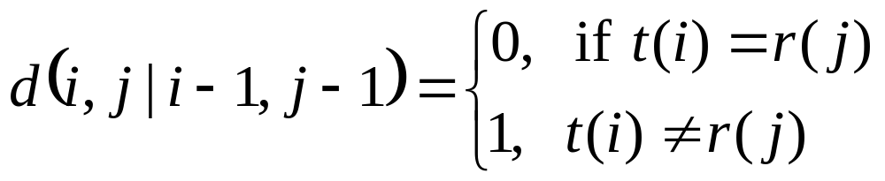
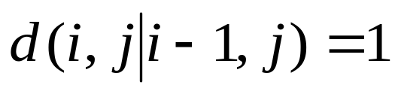
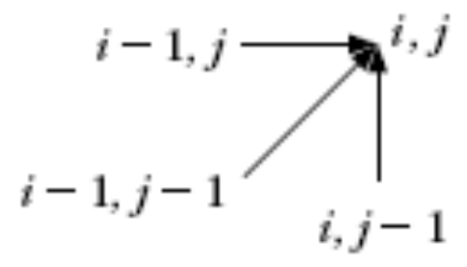
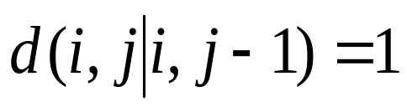
The Edit Distance
Cost D(0,0) = 0,
Complete path is searched
Allowable predecessors and costs
  Horizontal
  Vertical

Slide 4
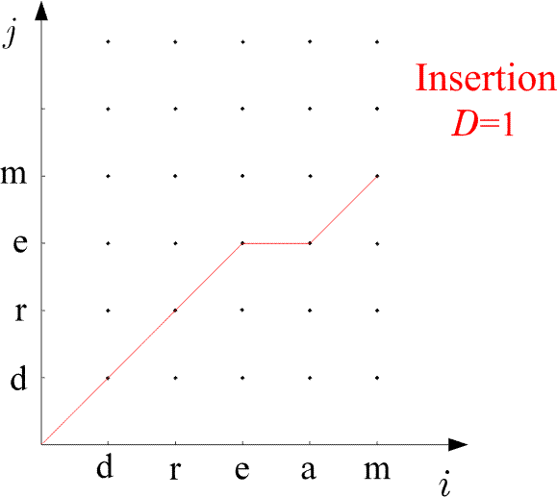
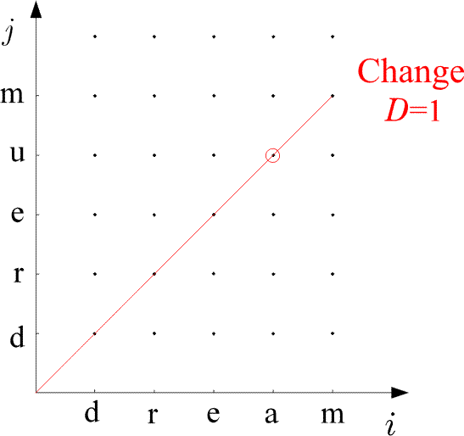
Examples:

Slide 5
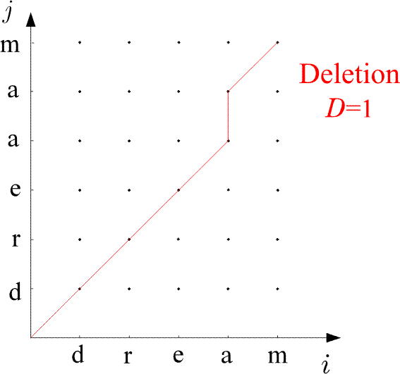
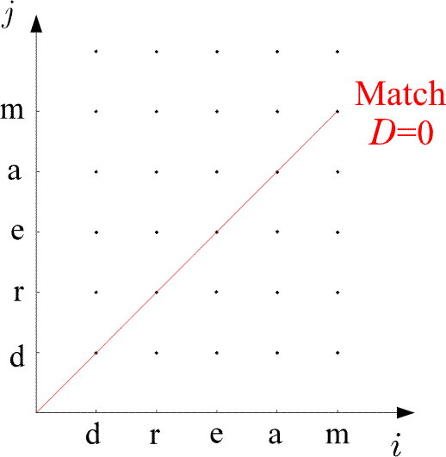
Examples:

Slide 6
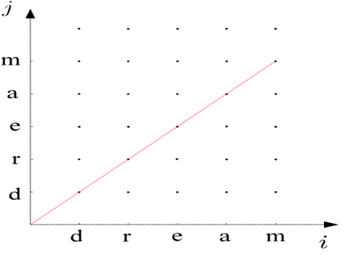
The Edit Distance
The Algorithm
  D(0,0)=0
  For i=1, to I
    D(i,0)=D(i-1,0)+1
  END {FOR}
  For j=1 to J
    D(0,j)=D(0,j-1)+1
  END{FOR}
  For i=1 to I
    For j=1, to J
      C₁=D(i-1,j-1)+d(i,j ׀ i-1,j-1)
      C₂=D(i-1,j)+1
      C₃=D(i,j-1)+1
      D(i,j)=min (C₁,C₂,C₃)
    END {FOR}
  END {FOR}
  D(A,B)=D(I,J)

Slide 7
Application of TM in Speech Recognition
A number of variations
  Speaker Independent Speech Recognition
  Speaker Dependent Speech Recognition
  Continuous Speech Recognition
  Isolated word recognition (IWR)

Slide 8
Application of TM in IWR
The goal:
  Given a number of known spoken words in a data base (reference patterns)
  find the best match of an unknown spoken word (test pattern).
Procedure:
  compare the test word against reference words

Slide 9
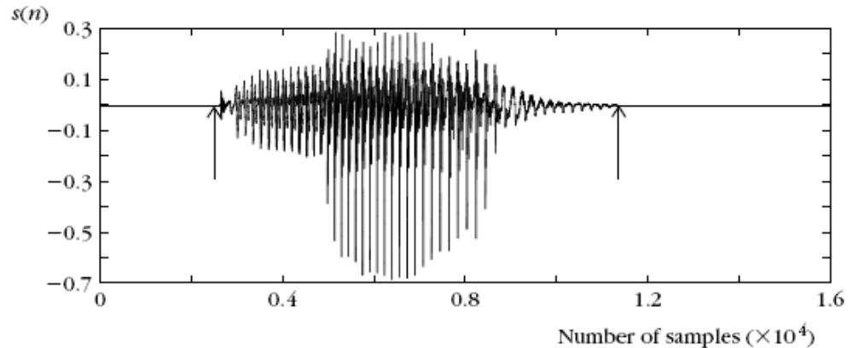
Application of TM in IWR

Slide 10
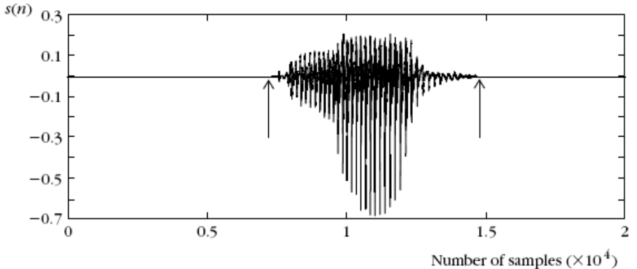
Application of TM in IWR

Slide 11


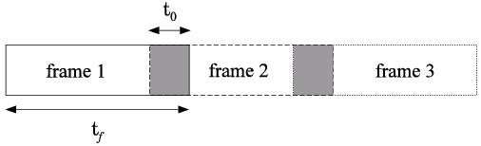
Application of TM in IWR
The procedure:
  Express the test and each of the reference patterns as sequences of feature vectors , , .
  To this end, divide each of the speech segments in a number of successive frames.

Slide 12
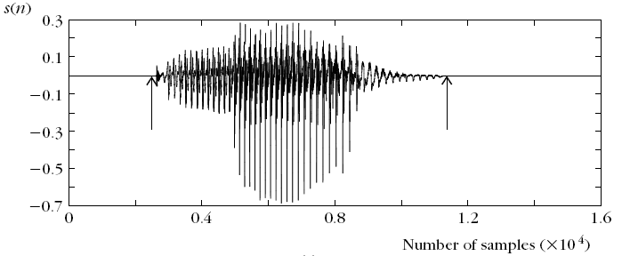
Application of TM in IWR
The procedure:
  Sample a speech segment from a microphone:

Slide 13
Application of TM in IWR
The procedure:
t_{f} = 512
t₀ = 100
Frame 1
Frame 2
Frame 2

Slide 14
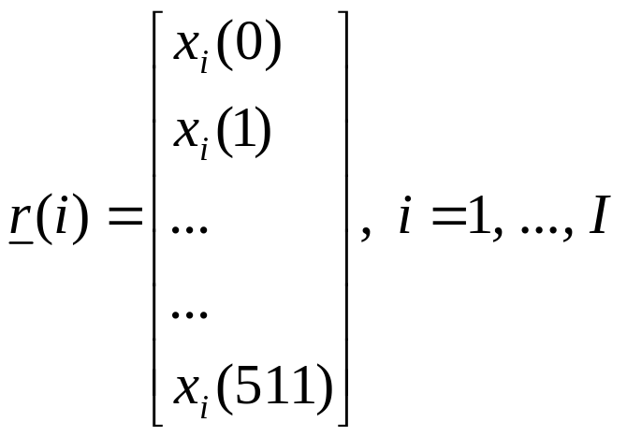
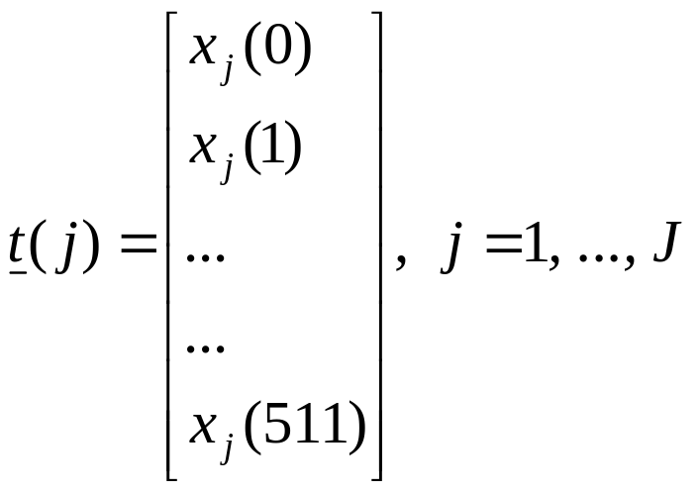
each frame is represented by a vector of 512 samples

Slide 15
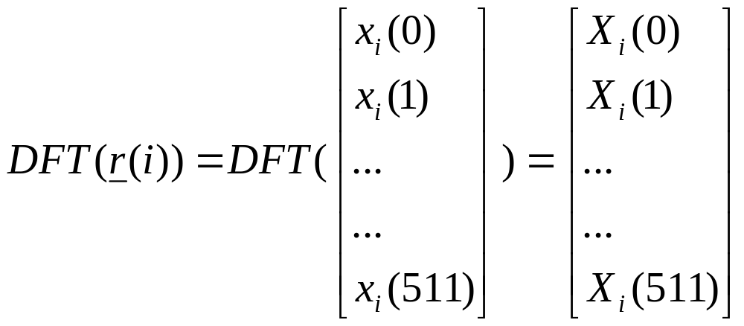

convert them to DFT

Slide 16
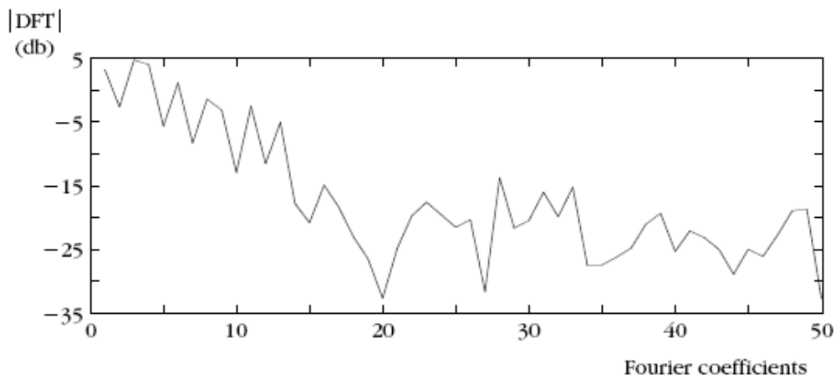
convert them to DFT

Slide 17
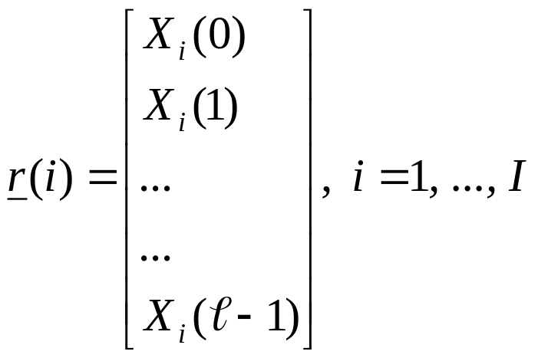
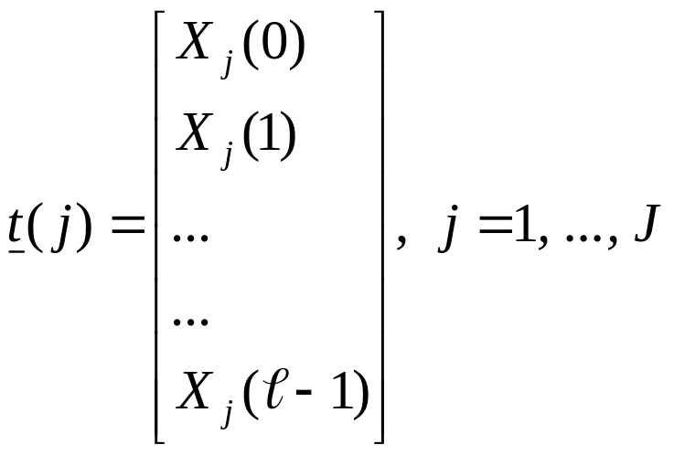
    For each frame compute a feature vector. For example, the DFT coefficients and use, say, ℓ of those:

Slide 18
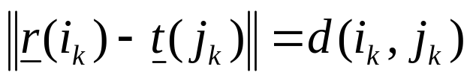
    For each frame compute a feature vector. For example, the DFT coefficients and use, say, ℓ of those:
    Choοse a cost function associated with each node across a path, e.g., the Euclidean distance

Slide 19
    For each frame compute a feature vector. For example, the DFT coefficients and use, say, ℓ of those:
    Choοse a cost function associated with each node across a path, e.g., the Euclidean distance
    find the optimal path in the grid
    Match the test pattern to the reference pattern associated with the optimal path

Slide 20
  Prior to performing the math one has to choose:
    end point constraints
    global constraints
    local constraints
    distance

Slide 21
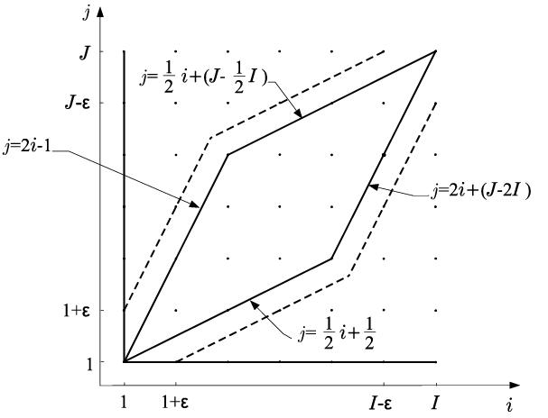
  Prior to performing the math one has to choose:
    The global constraints: Defining the region of space within which the search for the optimal path will be performed.

Slide 22

    The local constraints: monotonic path

Slide 23
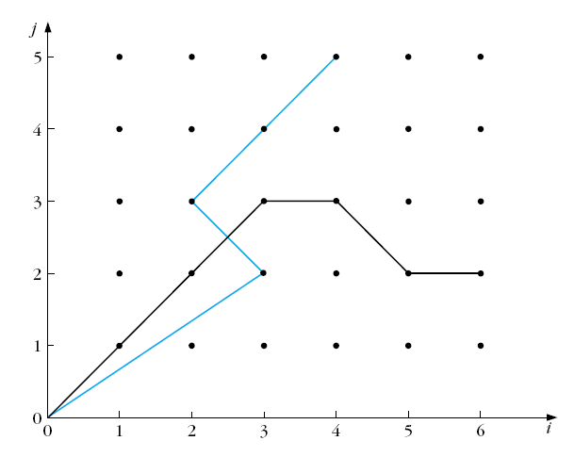
    The local constraints: monotonic path
    Non-monotonic path

Slide 24
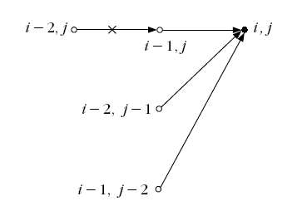
    The local constraints: Defining the type of transitions allowed between the nodes of the grid.
    Itakura local constraints

Slide 25
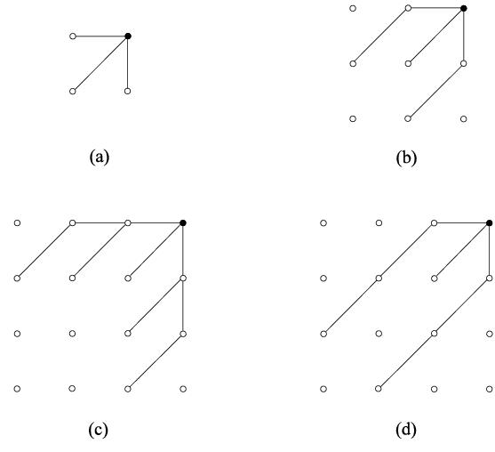
    The local constraints: Defining the type of transitions allowed between the nodes of the grid.
Sakoe and Chiba local constraints

Slide 26
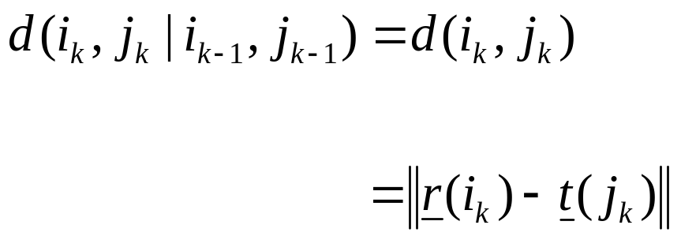
    cost function:
      Euclidean distance
      only node distance

Slide 27
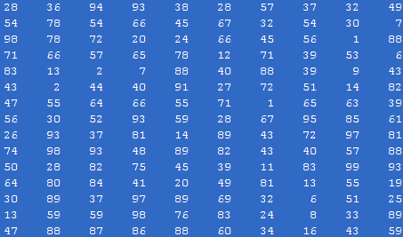

Correlation based TM
Goal: to find whether a specific known reference pattern resides within a given block of data.

Slide 28
Correlation based TM
Application: target detection, robot vision, video coding.
Frame at time t
Frame at time t-1

Slide 29
Correlation based TM
Application: target detection, robot vision, video coding.
Frame at time t
Frame at time t-1
Pixel value:
Pixel value:

Slide 30
Correlation based TM
Application: target detection, robot vision, video coding.
Frame at time t
Frame at time t-1
Pixel value:
Pixel value:
Difference:

Slide 31
Correlation based TM
Application: target detection, robot vision, video coding.
Frame at time t
Frame at time t-1
Pixel value:
Pixel value:
Difference:
We need to encode only the difference

Slide 32
Correlation based TM
There are two basic steps in such a procedure:
  Step 1: Move the reference pattern to all possible positions within the block of data. For each position, compute the “similarity” between the reference pattern and the respective part of the block of data.
  Step 2: Compute the best matching value.

Slide 33
Correlation based TM
There are two basic steps in such a procedure:
  Step 1: Move the reference pattern to all possible positions within the block of data. For each position, compute the “similarity” between the reference pattern and the respective part of the block of data.
  Step 2: Compute the best matching value.

Slide 34
Correlation based TM
There are two basic steps in such a procedure:
  Step 1: Move the reference pattern to all possible positions within the block of data. For each position, compute the “similarity” between the reference pattern and the respective part of the block of data.
  Step 2: Compute the best matching value.

Slide 35
Correlation In Image Matching
  Application to images: Given a reference image, r(i,j) of MxN size, and an IxJ image array t(i,j). Move r(i,j) to all possible positions (m,n) within t(i,j).
J
N
M
I
Reference, r
Test, t

Slide 36

Correlation In Image Matching
  Compute the distance:
    for every (m,n).
    For all (m,n), compute the minimum.

Slide 37
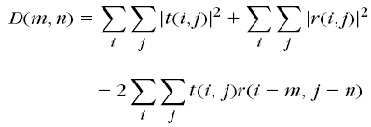
Correlation In Image Matching
The equation
can be written as

Slide 38
Correlation In Image Matching
In the equation
shaded terms are constant
provided pixel levels do not change much across the test image

Slide 39

Correlation In Image Matching
Canceling out the shaded terms, find point (m, n) that maximize:

Slide 40
Correlation In Image Matching
c (m, n) is no longer a difference term
This is called cross correlation

Slide 41

Correlation In Image Matching
In case gray level variation is valid, normalize:

Slide 42
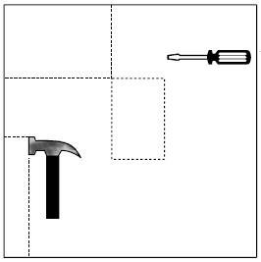

Correlation In Image Matching
Example:
Reference, r
Test Image, t

Slide 43
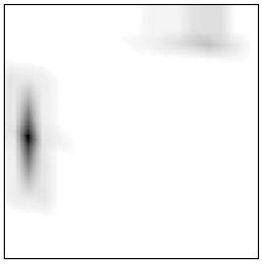
Correlation In Image Matching
Example:
Reference, r
Test Image, t
Correlation Image

Slide 44
Computation Considerations in Correlation Based TM (1)
Find c (m,n) at every pixel
This equation looks like convolution operation
Alternate is to calculate in the frequency domain

Slide 45
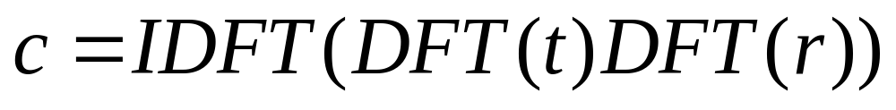
Computation Considerations in Correlation Based TM (1)
The frequency domain representation of
is

Slide 46
Computation Considerations in Correlation Based TM (2)
Limit the search space
  Search only in the area of [-p, p] X [-p, p] centered at (x, y)
r

Slide 47
Computation Considerations in Correlation Based TM (2)
Limit the search space
  Search only in the area of [-p, p] X [-p, p] centered at (x, y)
r

Slide 48
Computation Considerations in Correlation Based TM (2)
Limit the search space
  Search only in the area of [-p, p] X [-p, p] centered at (x, y)
r
(x, y)
(x + p, y + p)

Slide 49
Computation Considerations in Correlation Based TM (2)
Limit the search space
  Search only in the area of [-p, p] X [-p, p] centered at (x, y)
r
(x, y)
(x - p, y - p)

Slide 50
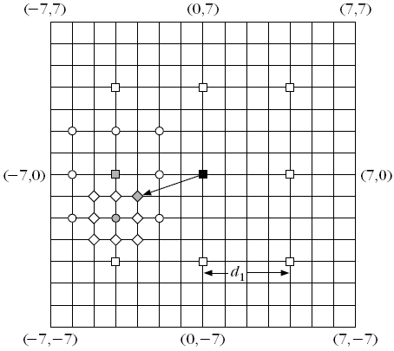
Computation Considerations in Correlation Based TM (3)
2D Logarithmic search
  Start with a rectangle of size [-p, p] X [-p, p]

Slide 51
Computation Considerations in Correlation Based TM (3)
2D Logarithmic search
  Search only at 9 points separated by d₁

Slide 52
Computation Considerations in Correlation Based TM (3)
2D Logarithmic search
  Maximum found at dark red

Slide 53
Computation Considerations in Correlation Based TM (3)
2D Logarithmic search
  Search in the rectangle of size [-p/4, p/4] X [-p/4, p/4] centered at dark red

Slide 54
Computation Considerations in Correlation Based TM (3)
2D Logarithmic search
  Maximum found at green

Slide 55
Computation Considerations in Correlation Based TM (3)
2D Logarithmic search
  Search in the rectangle of size [-p/8, p/8] X [-p/8, p/8] centered at green

Slide 56
Computation Considerations in Correlation Based TM (3)
2D Logarithmic search
  Maximum found at purple

Slide 57
Computation Considerations in Correlation Based TM (3)
Complexity MN(8k+1)

Slide 58
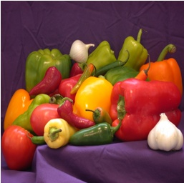

Computation Considerations in Correlation Based TM (4)
Hierarchical Search
  Search the reference in the area of size [-p, p] X [-p, p] centered at (x, y)
  Let, reference be of size 16X16
reference
test

Slide 59


Computation Considerations in Correlation Based TM (4)
Hierarchical Search
Level 0
Low pass Filter of Level 0
Original reference and test image

Slide 60


Computation Considerations in Correlation Based TM (4)
Hierarchical Search
Sub-sampled by 2
Level 0
Low pass Filter of Level 0
Level 1

Slide 61



Computation Considerations in Correlation Based TM (4)
Hierarchical Search
Level 1
Low pass Filter of Level 1
Sub-sampled by 2
Level 2

Slide 62
Computation Considerations in Correlation Based TM (4)
Hierarchical Search
. . . .
Level 0
Level 1
Level 2

Slide 63
Computation Considerations in Correlation Based TM (4)
Hierarchical Search

Slide 64
Computation Considerations in Correlation Based TM (4)
Hierarchical Search
2p
2p
(x, y)

Slide 65
Computation Considerations in Correlation Based TM (4)
Hierarchical Search
p/2
p
2p
(x/2, y/2)
(x/4 y/4
(x, y)
Level 0
Level 1
Level 2

Slide 66
Computation Considerations in Correlation Based TM (4)
Hierarchical Search
  Start at Level 2 with the reference of size 4X4
  Search in the rectangle [-p/4, p/4] [-p/4, p/4] centered at (x/4, y/4)

Slide 67
Computation Considerations in Correlation Based TM (4)
Hierarchical Search
  Start at Level 2 with the reference of size 4X4
  Search in the rectangle [-p/4, p/4] [-p/4, p/4] centered at (x/4, y/4)
  Let optimal found at (x₁, y₁) with respect to (x/4, y/4).

Slide 68
Computation Considerations in Correlation Based TM (4)
Hierarchical Search
  At Level 1, with the reference of size 8X8
  Search in the rectangle [-1, 1] X [-1, 1]
  centered at (x/2 +2x₁, y/2+2y₁)

Slide 69
Computation Considerations in Correlation Based TM (4)
Hierarchical Search
  At Level 1, with the reference of size 8X8
  Search in the rectangle [-1, 1] X [-1, 1]
  centered at (x/2 +2x₁, y/2+2y₁)
  Let optimal found at (x₂, y₂) with respect to (x/2, y/2).

Slide 70
Computation Considerations in Correlation Based TM (4)
Hierarchical Search
  At Level 0, with the reference of size 16X16
  Search in the rectangle [-1, 1] X [-1, 1]
  centered at (x +2x₂, y+2y₂)

Slide 71
Computation Considerations in Correlation Based TM (4)
Hierarchical Search
  At Level 0, with the reference of size 16X16
  Search in the rectangle [-1, 1] X [-1, 1]
  centered at (x +2x₂, y+2y₂)
  Location at this time is the final one

Slide 72
Computation Considerations in Correlation Based TM (4)
Complexity of Hierarchical Search
  9 × No. of Decompositions +
  Complexity at highest level

